Slide 1

Healthcare Analysis SQL Capstone
Immunization Program Performance Across Asia
Prepared By: Stella Sirleaf
Tools Used: PostgreSQL , Excel

Slide 2
Project Background
Business Problem
The Ministry of Health wanted to evaluate immunization programs across Asian countries to understand vaccination trends and support public health decision-making.
Objective
Use SQL to analyze immunization data and answer important business questions related to vaccine administration, country performance, and regional vaccination coverage.

Slide 3

Dataset Overview
The project uses two related tables.
Table 1 – Countries
Contains:
Country ID
Country Name
Region
Population (Millions)
Table 2 – Immunization Records
Contains:
Record ID
Country ID
Vaccine Name
Vaccinations Given
Report Year
Relationship
The two tables are connected using Country ID, allowing vaccination records to be linked to the correct country.

Slide 4

SQL Skills Demonstrated
SQL Techniques Used
SELECT
WHERE
INNER JOIN
GROUP BY
SUM()
AVG()
HAVING
ORDER BY
LIMIT
Skills Developed
Data retrieval
Data aggregation
Table relationships
Business analysis
Public health reporting

Slide 5
Business Questions Answered
Which vaccine was administered the most?
Which countries administered the highest number of vaccinations?
Which regions administered more than 500,000 vaccine doses?
Which vaccine was administered the least?
Which countries recorded the highest average number of vaccinations per report?

Slide 6
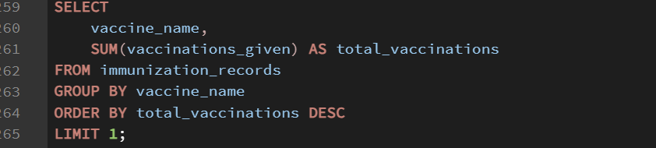
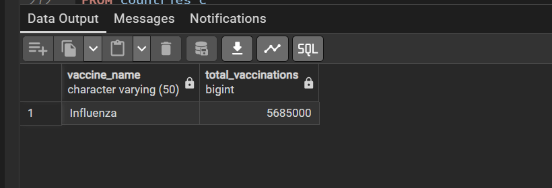
Question 1
Which Vaccine Was Administered the Most?
SQL Query
Result

Slide 7
Most Administered Vaccine
Business Insight
Influenza recorded the highest number of vaccinations across the dataset, suggesting it was the most widely administered vaccine during the reporting period.

Slide 8
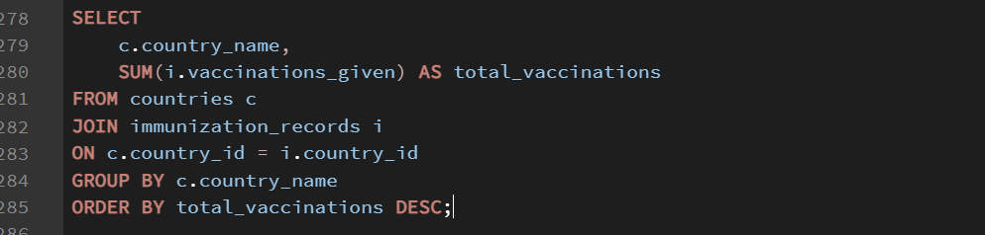
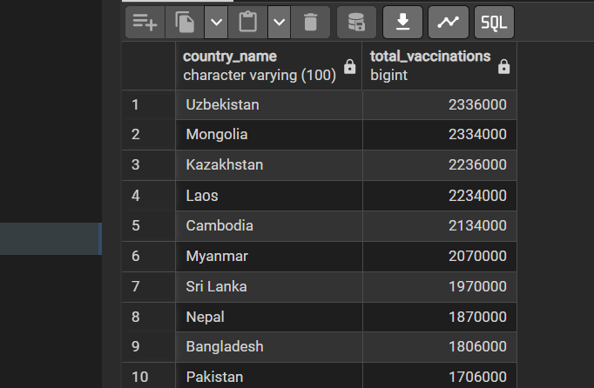
Question 2
Which Countries Administered the Highest Number of Vaccinations?
SQL Query
Result

Slide 9
Top 5 Countries by Total Vaccinations
Business Insight
The countries with the highest vaccination totals demonstrate strong vaccination activity within the dataset.
These findings help identify the highest-performing countries and provide valuable information for comparing immunization efforts across the region.

Slide 10
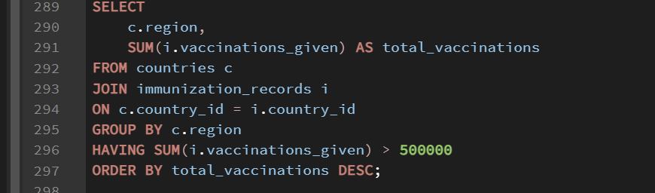
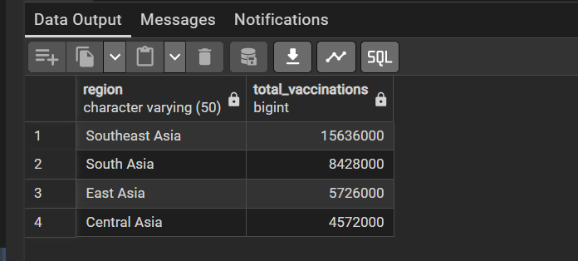
Question 3
Regions With More Than 500,000 Vaccinations
SQL Query
Result

Slide 11
Regions With More Than 500,000 Vaccinations
Business Insight
Southeast Asia recorded the highest vaccination total with 15,636,000 vaccinations, followed by South Asia. These findings indicate that vaccination activity was concentrated in a few high-performing regions, highlighting areas that require continued monitoring and sustained immunization efforts.
One notable observation is that Southeast Asia administered more than three times the number of vaccinations recorded in Central Asia, suggesting considerable variation in vaccination activity across the regions."

Slide 12
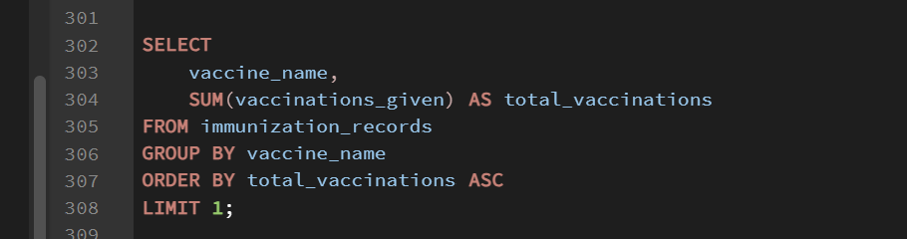
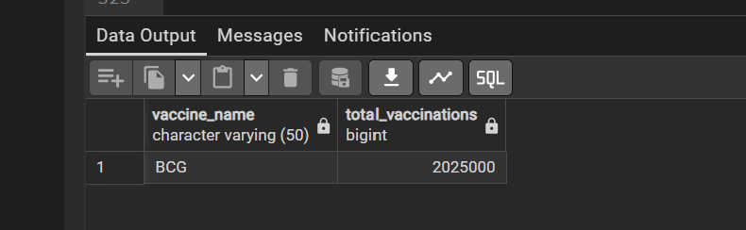
Question 4 Least Administered Vaccine
SQL Query
Result

Slide 13
Least Administered Vaccine by Total Vaccinations
Business Insight
BCG recorded the lowest total vaccinations, with 2,025,000 doses administered. This finding may indicate lower utilization within the dataset and highlights an opportunity for the Ministry of Health to further investigate factors influencing its administration.

Slide 14
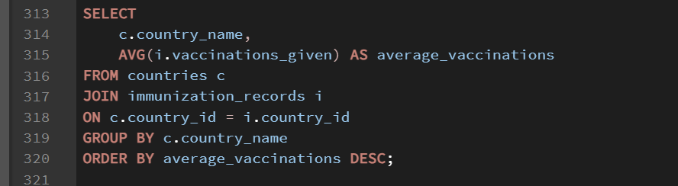
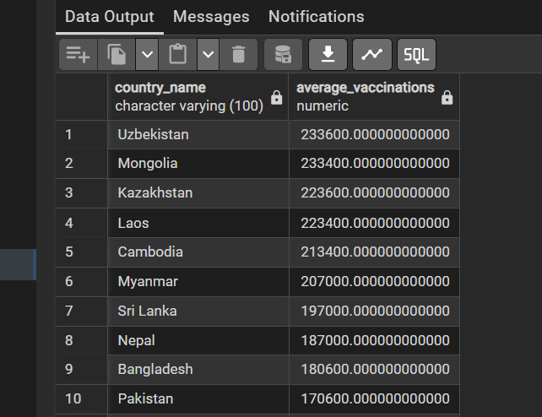
Question 5
Countries With the Highest Average Vaccinations Per Report
SQL Query
Result

Slide 15
Top 5 Countries by Average Vaccinations per Report
Business Insight
Uzbekistan recorded the highest average vaccinations per report at 233,600, followed closely by Mongolia at 233,400. These results identify the countries with the strongest average vaccination activity in the dataset.
The difference between Uzbekistan and Mongolia was only 200 vaccinations per report, showing very similar average performance.

Slide 16

Recommendations
Continue monitoring vaccination performance to identify low-coverage areas.
Investigate factors contributing to low administration of certain vaccines and address supply or accessibility challenges.
Share successful vaccination strategies from high-performing countries to improve immunization programs across the region.
Use data-driven monitoring to support future immunization planning and resource allocation.

Slide 17
Conclusion
In conclusion, this analysis demonstrates how SQL can transform raw healthcare data into meaningful insights that support evidence-based public health decision-making.
Thank you for your attention.

